Slide 1
Project Tracker App
Using Model Drive App
Sachchin Annam

Slide 2
Contents
Introduction
Data points of Project Tracker
Entity Relationship
Application Features
Notifications
Glimpse of Project Tracker App

Slide 3
Introduction
Project Tracker app is a Power App application developed using Model Driven App approach.
This Application lets Managers and team members to measure the progress of the team at project and its intended activities.
Project Tracker app, is a one place stop to track and manage:
Project against technologies and nature of activities.
Resource allocation against the projects.
Tasks, and Issues of the projects.
Milestones and Dependencies, if any.

Slide 4


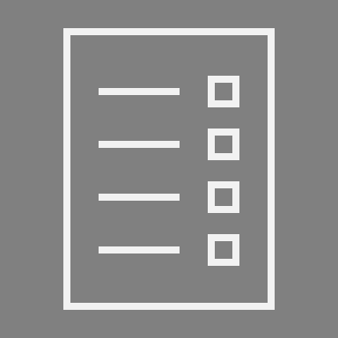



Data Points of Project Tracker
Tasks
Issues
Tasks against respective projects would be tracked.
Issues for peer review/UAT would be tracked.
Projects
Placeholder to track Projects/activity
Resources
Milestones
Resources allocated to the project and their allocated %
Track Project Milestones.
Dependencies/Risks

Slide 5
Entity Relationship
Parent Entity
Child Entities
Projects
Title | Type | Status
HAS
Tasks
Project | Title | Status
Issues
Project | Title | Status
Milestones
Project | Title | Status
Dependencies
Project | Title | Status
Resources Allocated
Project | Associate | % Allocated

Slide 6






Application Features
Centralized Data
Data forms
Email Notifications
Data is segregated for Projects, Tasks and Issue
Pre-configured forms for capturing data at Project, Task, Issues, Milestones and Dependencies
Email notifications on data creation and modifications
Visual Dashboard
App Notifications
Scheduled Summary
Dashboard to narrate the story of projects, tasks and issues’ progress
App level notifications for Tasks and Issues assignment
Summary email/Weekly Summary with all in-progress Tasks and Issues to Associates/Mgr.

Slide 7


Notifications
Email Notifications
Power Automate Email Notifications on:
New Project Creation and Update.
Task Creation and Update
Issue Creation and Update
Recurring notifications for in-progress tasks and issues post due-date.
In-App Notifications
In-App personalized notifications for assigned to associates
Task Creation and Update
Issue Creation and Update

Slide 8
Glimpse of Project Tracker App

Slide 9
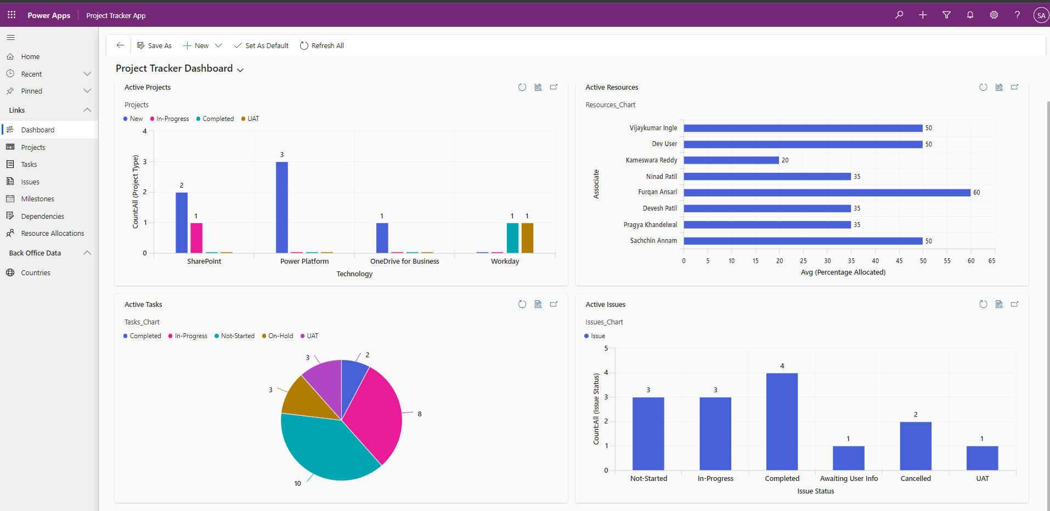
Project Tracker App - Dashboard

Slide 10
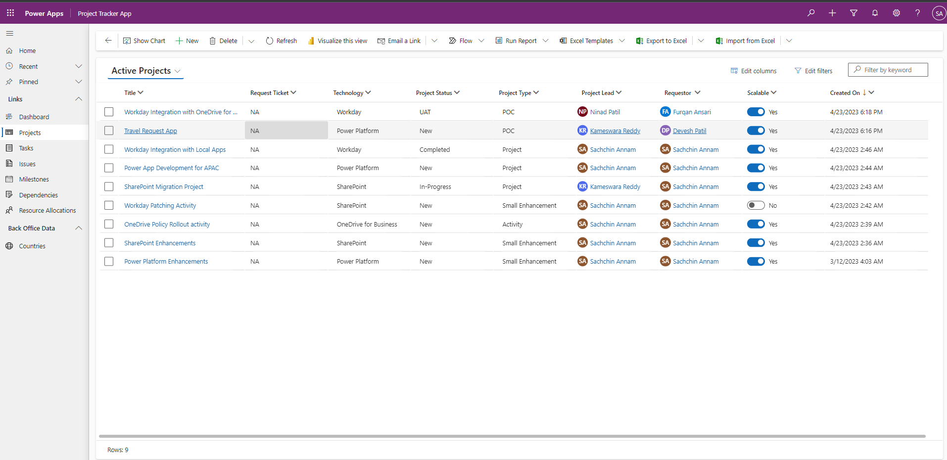
Project Tracker App - Project View

Slide 11
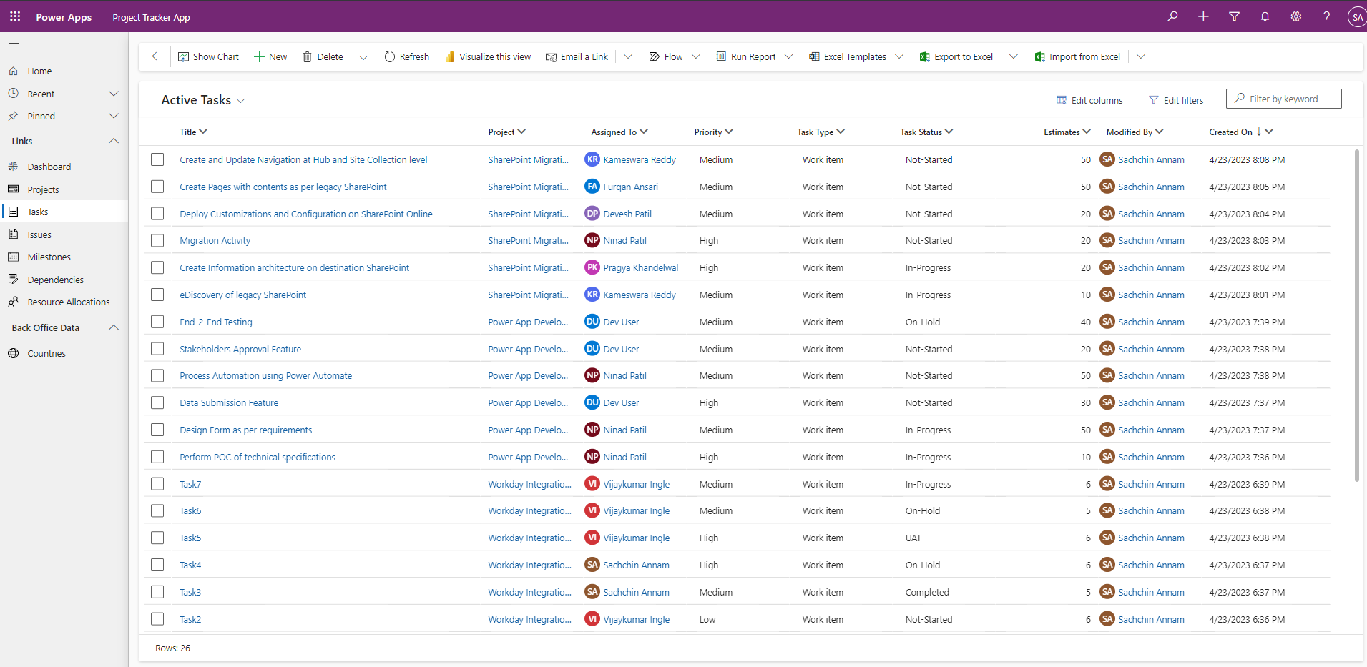
Project Tracker App - Tasks View

Slide 12
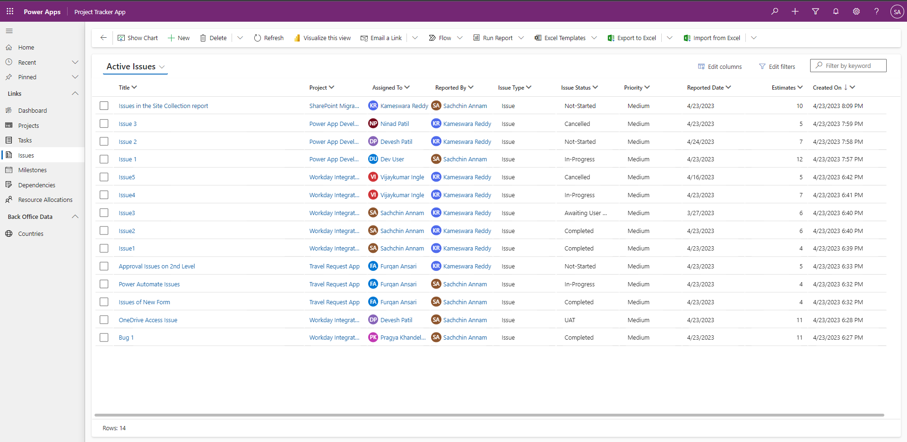
Project Tracker App - Issues View

Slide 13
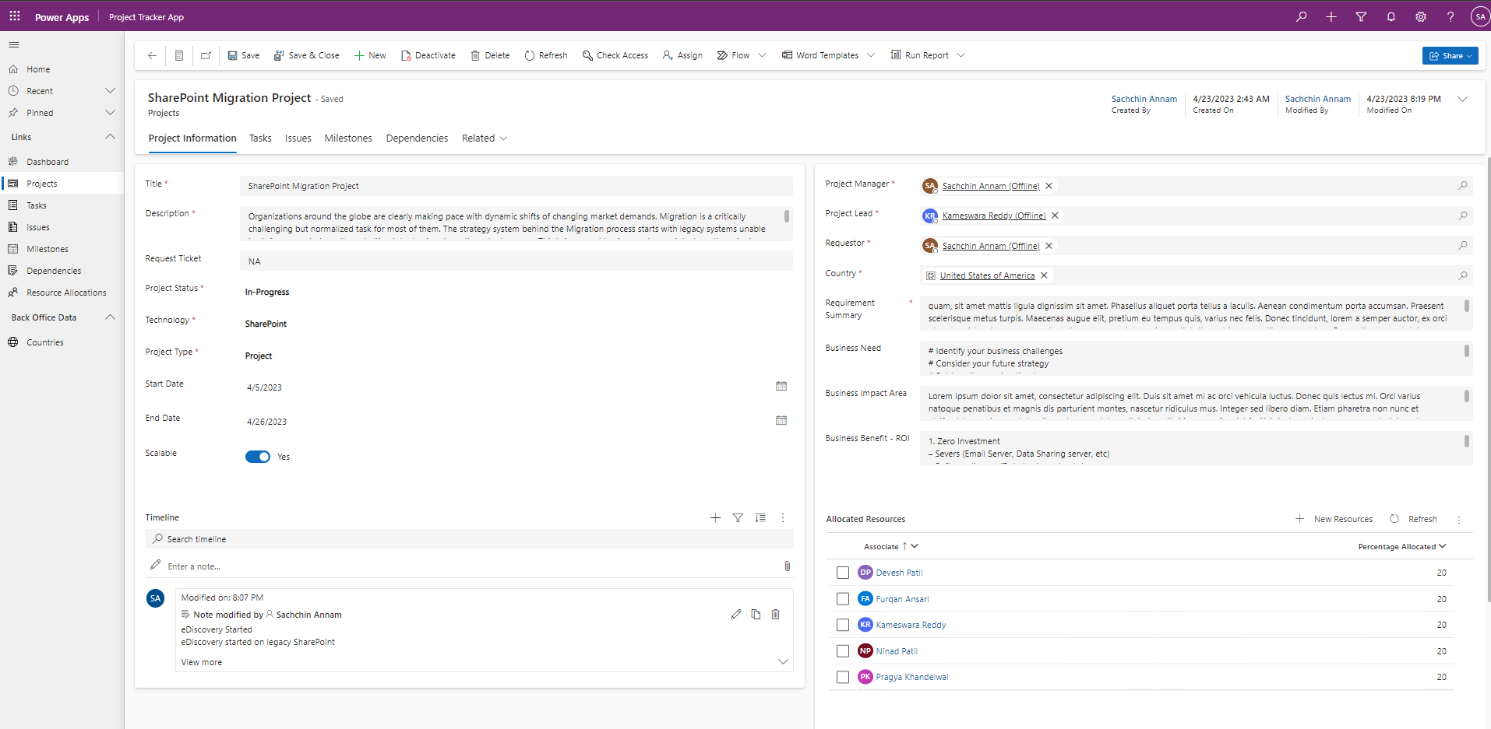
Project Tracker App - Project Intake Form

Slide 14
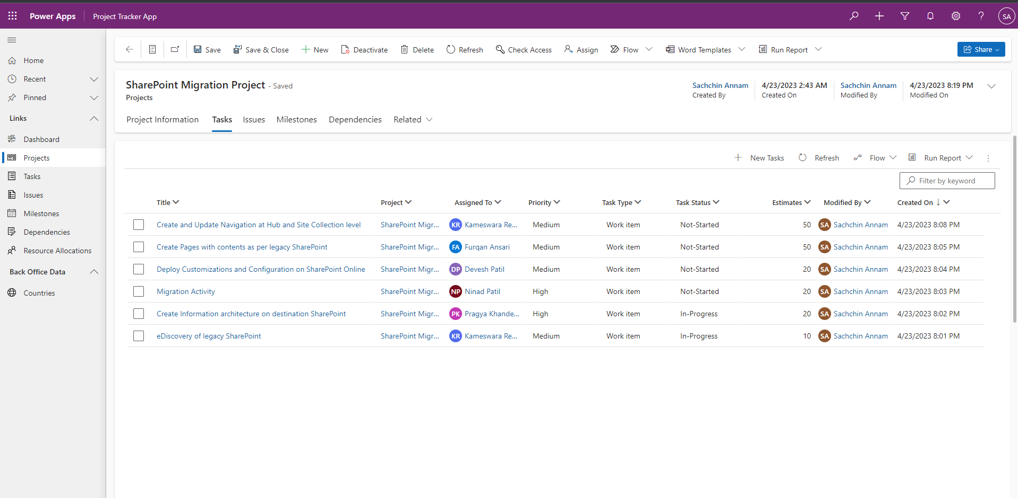
Project Tracker App - Project’s Tasks View

Slide 15
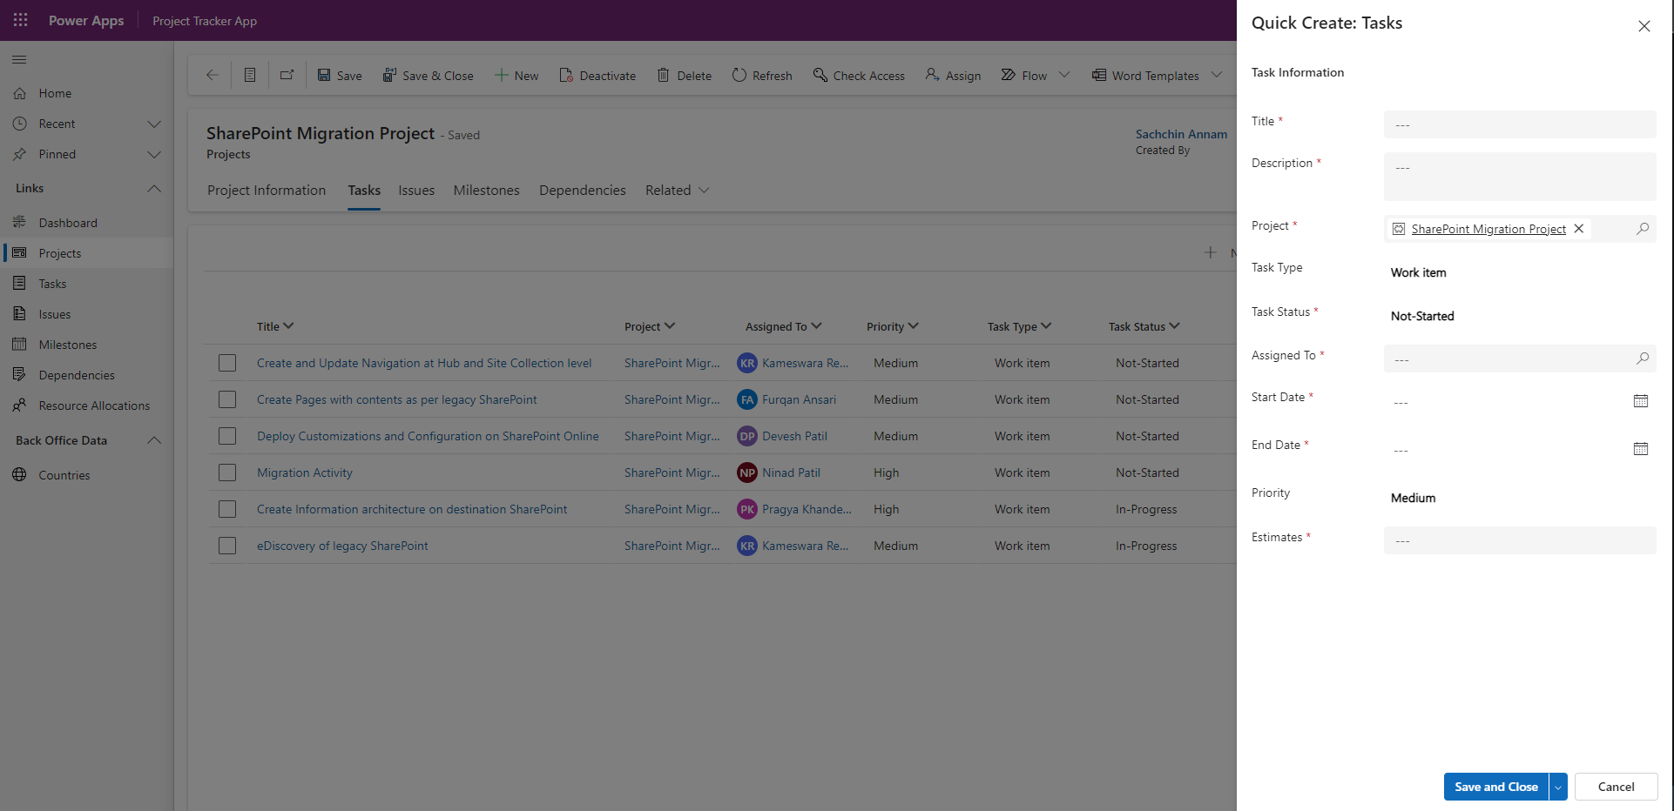
Project Tracker App - Tasks: Quick Create Form

Slide 16
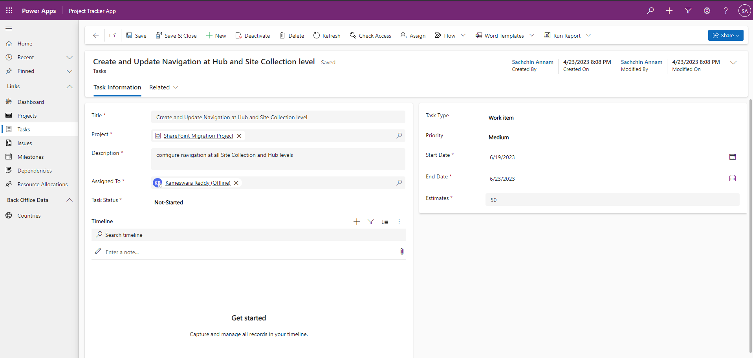
Project Tracker App - Tasks: Main Form

Slide 17
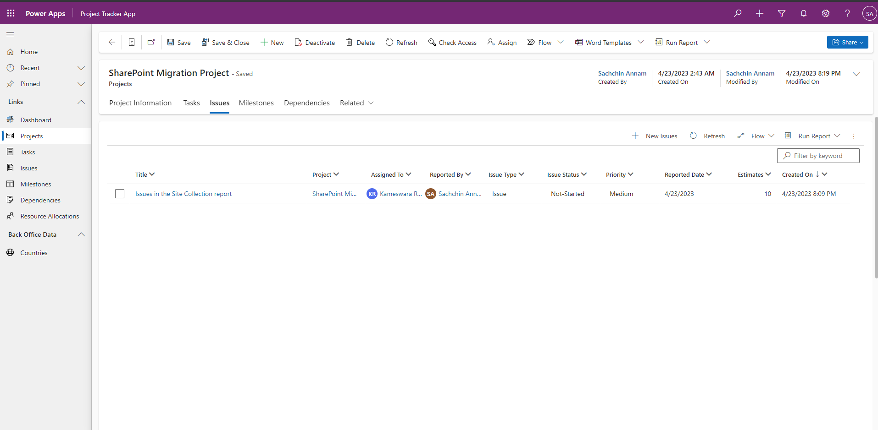
Project Tracker App - Project’s Issues View

Slide 18
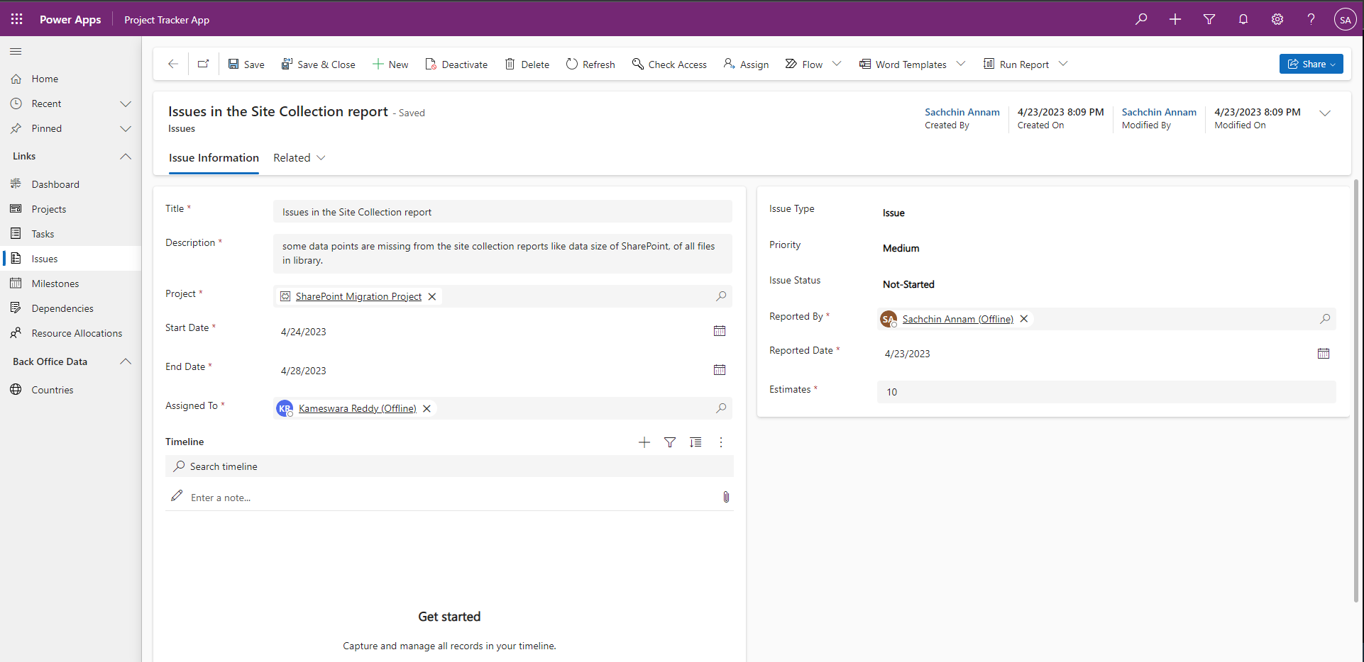
Project Tracker App - Issues: Main Form

Slide 19
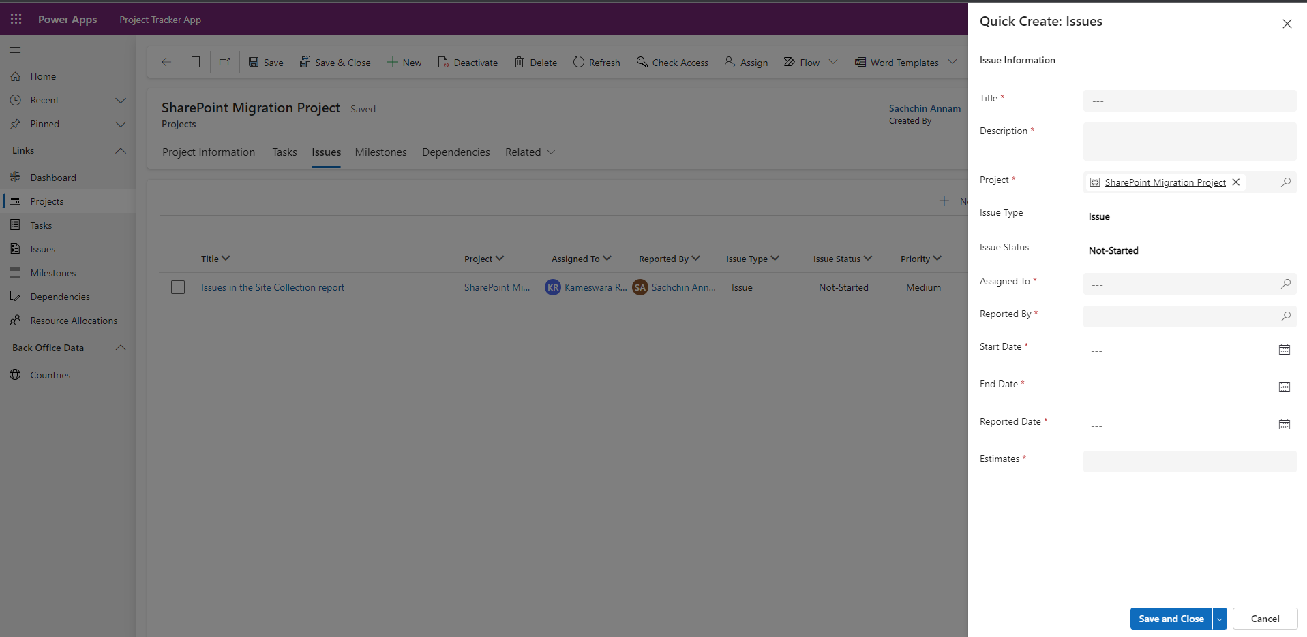
Project Tracker App - Issues: Quick Create Form

Slide 20
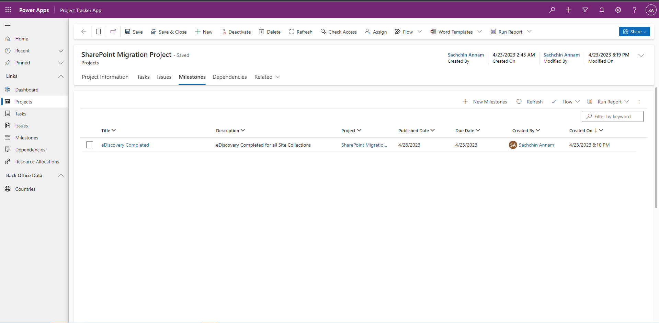
Project Tracker App - Project’s Milestones View

Slide 21
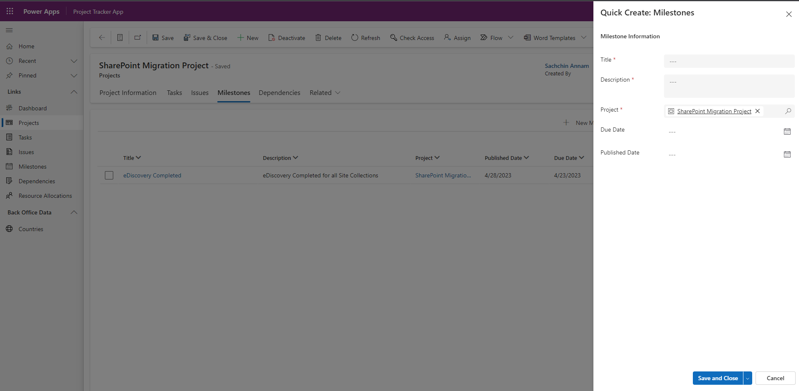
Project Tracker App - Milestones: Quick Create Form

Slide 22
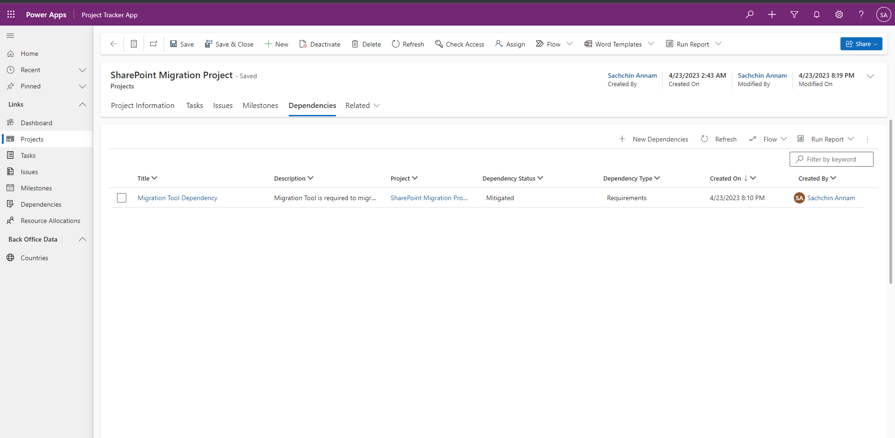
Project Tracker App - Project’s Dependencies View

Slide 23
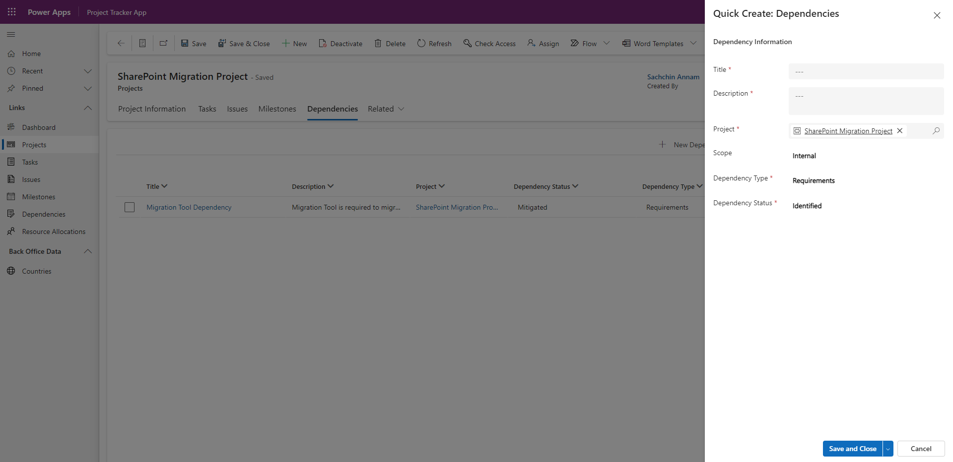
Project Tracker App - Dependencies: Quick Create Form

Slide 24
Thanks for your time. For any queries, kindly message me on LinkedIn: https://www.linkedin.com/in/sachchinannam/

